Slide 1
File Systems
Chapter 4
Files
Directories
File system implementation
Example file systems

Slide 2
Long-term Information Storage
Must store large amounts of data
Information stored must survive the termination of the process using it
Multiple processes must be able to access the information concurrently

Slide 3
Naïve Solution
Think of a disk as a linear sequence of fixed-size blocks and supporting two operations:
Read block k
Write block k

Slide 4
Problems?
How do you find information?
How do you keep one user from reading another user’s data?
How do you know which blocks are free?

Slide 5
New Abstraction: The File
Three most important concepts relating to operating systems:
abstractions of processes (and threads)
address spaces
files

Slide 6
File
Files are logical units of information created by processes.
  A disk will usually contain thousands or even millions of them, each one independent of the others.
Files are used to model the disk.

Slide 7
Essential Properties of Files
Processes can read existing files and create new ones if need be.
Information stored in files must be persistent, that is, not be affected by process creation and termination.
A file should disappear only when its owner explicitly removes it.

Slide 8
OS and Files
Files are managed by the operating system.
How they are structured, named, accessed, used, protected, implemented, and managed are major topics in OS design.
As a whole, that part of the OS dealing with files is known as the file system.

Slide 9
Summary
A file is an abstraction mechanism.
It provides a way to store information on the disk and read it back later.
This must be done in such a way as to shield the user from the details of how and where the information is stored, and how the disks actually work.

Slide 10
File Naming
When a process creates a file, it gives the file a name.
When the process terminates, the file continues to exist and can be accessed by other processes using its name.
The exact rules for file naming vary somewhat from system to system.

Slide 11
File Naming (contd.)
File names are case-sensitive.
  UNIX
File names are not case-sensitive.
  MS-DOS

Slide 12
Some Popular File Systems
FAT-16
  FAT = File Allocation Table
FAT-32 (since Windows 98)
exFAT
NTFS (New Technology File System)
ReFS (Resilient File System)

Slide 13
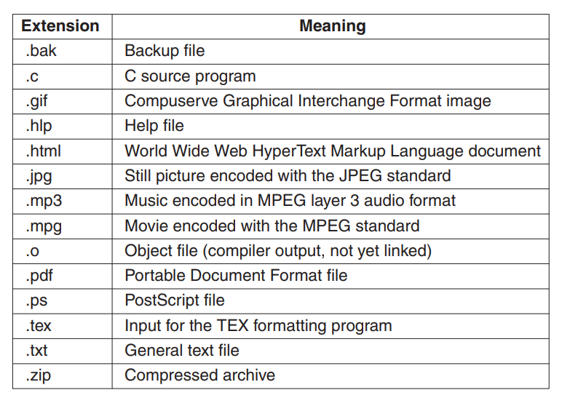
Typical File Extensions
In some systems (e.g., all flavors of UNIX) file extensions are just conventions and are not enforced by the operating system.

Slide 14
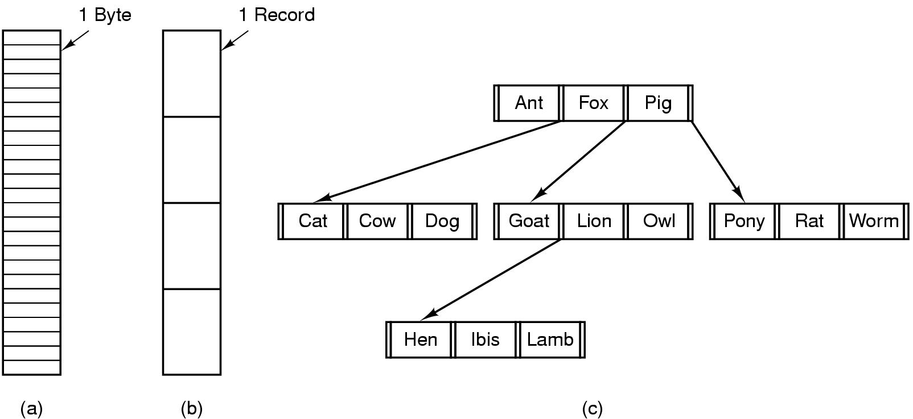
File Structure
Three kinds of files
  byte sequence
  record sequence
  tree

Slide 15
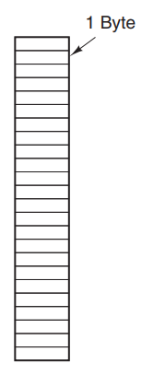
Byte Sequence
The operating system does not know or care what is in the file. All it sees are bytes.
Any meaning must be imposed by user-level programs.
Both UNIX and Windows use this approach.
Advantage: maximum amount of flexibility

Slide 16
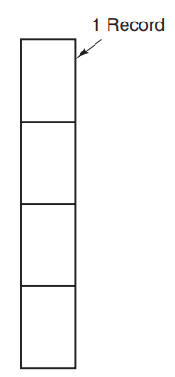
Record Sequence
A file is a sequence of fixed-length records, each with some internal structure.
Read operation returns one record and write operation overwrites or appends one record.
Previously in mainframe computers, programs read input in units of 80 characters and wrote it in units of 132 characters, although the final 52 could be spaces, of course.
No current general-purpose system uses this model as its primary file system anymore.

Slide 17
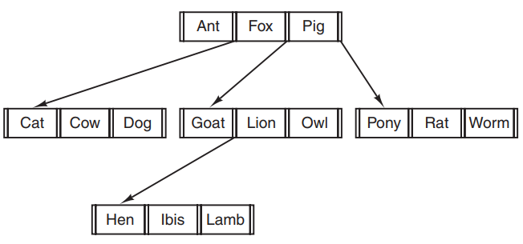
Tree
A file consists of a tree of records, not necessarily all the same length, each containing a key field in a fixed position in the record.
The tree is sorted on the key field, to allow rapid searching for a particular key.

Slide 18
Tree (contd.)
For the zoo file, one could ask the system to get the record whose key is pony without worrying about its exact position in the file.
Used on some large mainframe computers for commercial data processing

Slide 19
File Types
Regular files
  contain user information
Directories
  system files for maintaining the structure of the file system
Character special files
  related to input/output and used to model serial I/O devices, such as terminals, printers, and networks
Block special files
  used to model disks

Slide 20
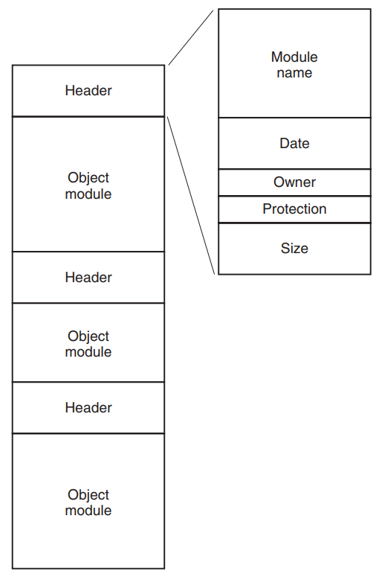
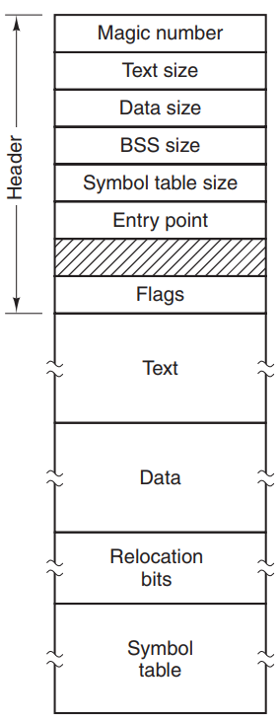
Regular Files
Generally, either ASCII files or binary files
ASCII files consist of lines of text.
A simple executable binary file taken from an early version of UNIX
An archive (binary file), from UNIX

Slide 21
File Access
Sequential access
  read all bytes/records from the beginning
  cannot jump around, could rewind or back up
  convenient when medium was mag tape
Random access
  read bytes/records of a file in any order
  essential for database systems

Slide 22
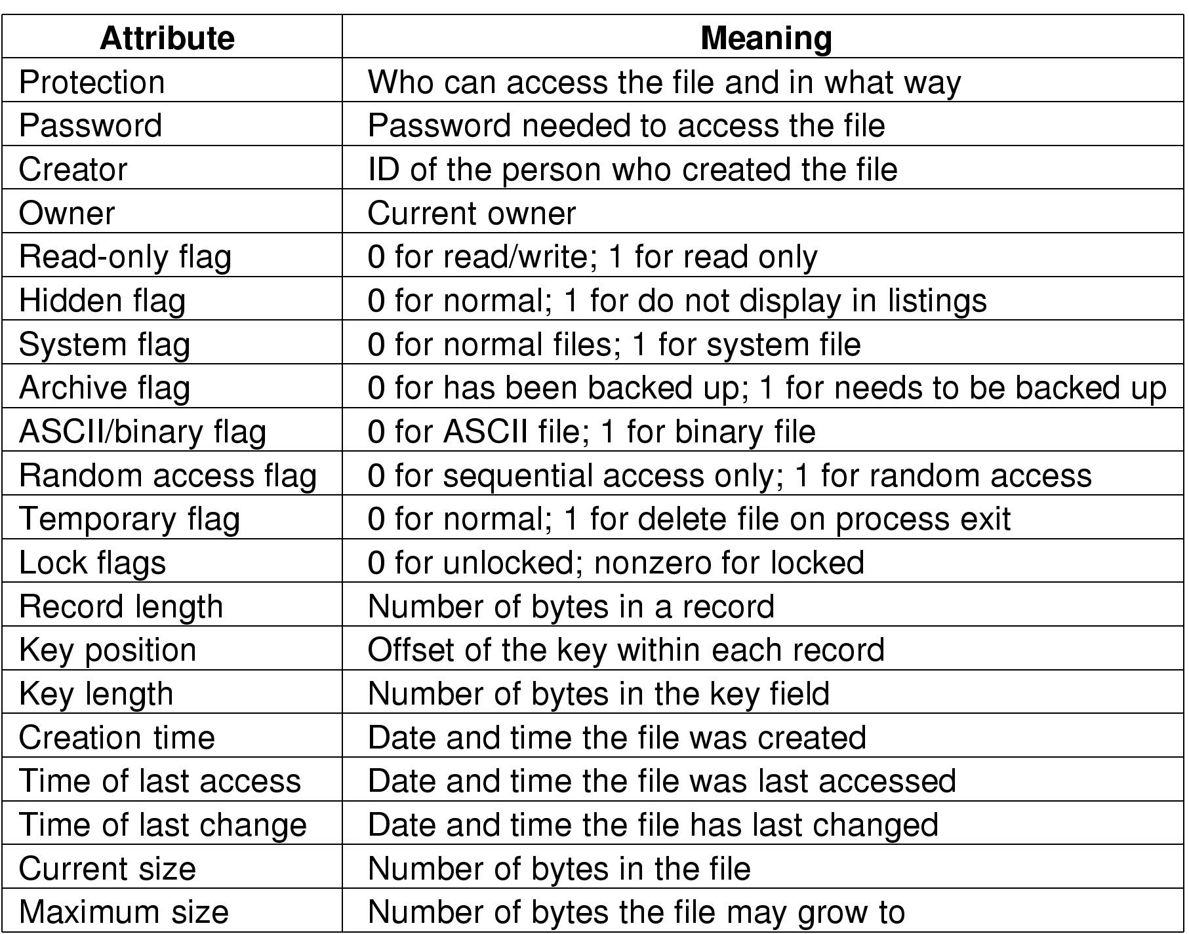
File Attributes
Possible file attributes

Slide 23
File Operations
Most common system calls relating to files:
  Create
  Delete
  Open
  Close
  Read
  Write
  Append
  Seek
  Get attributes
  Set Attributes
  Rename

Slide 24
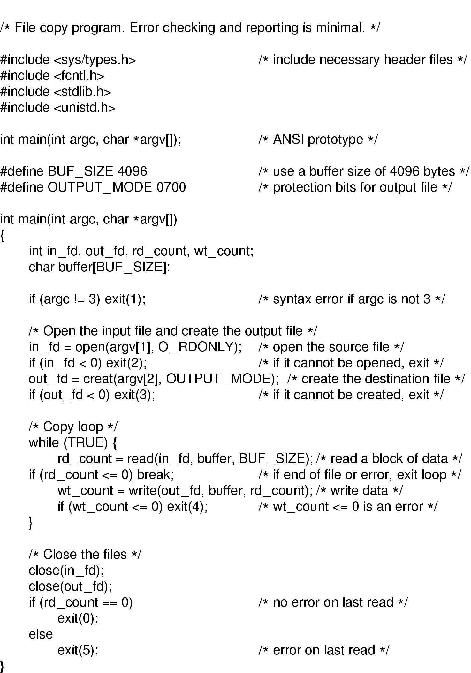
An Example Program Using File System Calls (1/2)

Slide 25
An Example Program Using File System Calls (2/2)

Slide 26
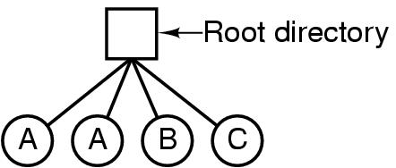
Directories/Folders
Single-Level Directory Systems
A single level directory system (figure above)
  contains 4 files
  owned by 3 different people, A, B, and C
Still used on simple embedded devices such as digital cameras and some portable music players

Slide 27
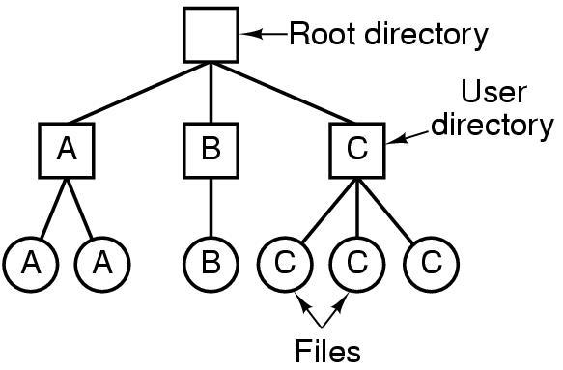
Two-level Directory Systems
Letters indicate owners of the directories and files

Slide 28
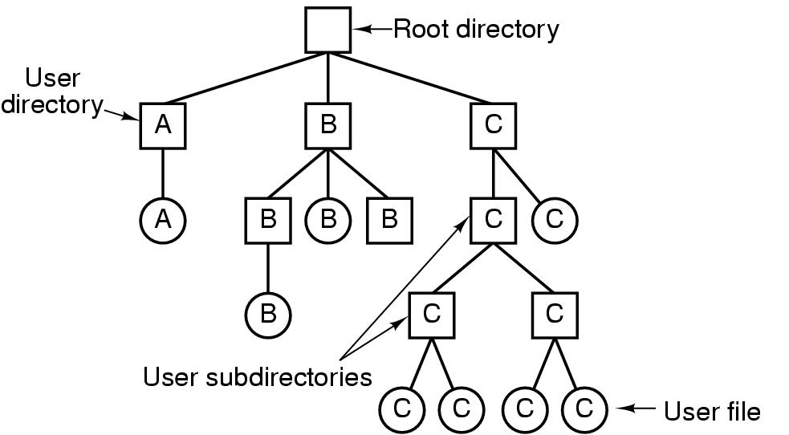
Hierarchical Directory Systems
A hierarchical directory system

Slide 29
Path Names
Absolute path name
  consisting of the path from the root directory to the file
  Example:
  Windows: \usr\ast\mailbox
  UNIX: /usr/ast/mailbox
  MULTICS: >usr>ast>mailbox

Slide 30
Path Names (contd.)
Relative path name
  Relative to working directory/current directory
Example:
cp /usr/ast/mailbox /usr/ast/mailbox.bak
  and the command
cp mailbox mailbox.bak
  do exactly the same thing if the working directory is /usr/ast

Slide 31
Changing Working Directory
A process can change its working directory without any side-effect.
If a library procedure changes the working directory and does not change back to where it was when it is finished, the rest of the program may not work.

Slide 32
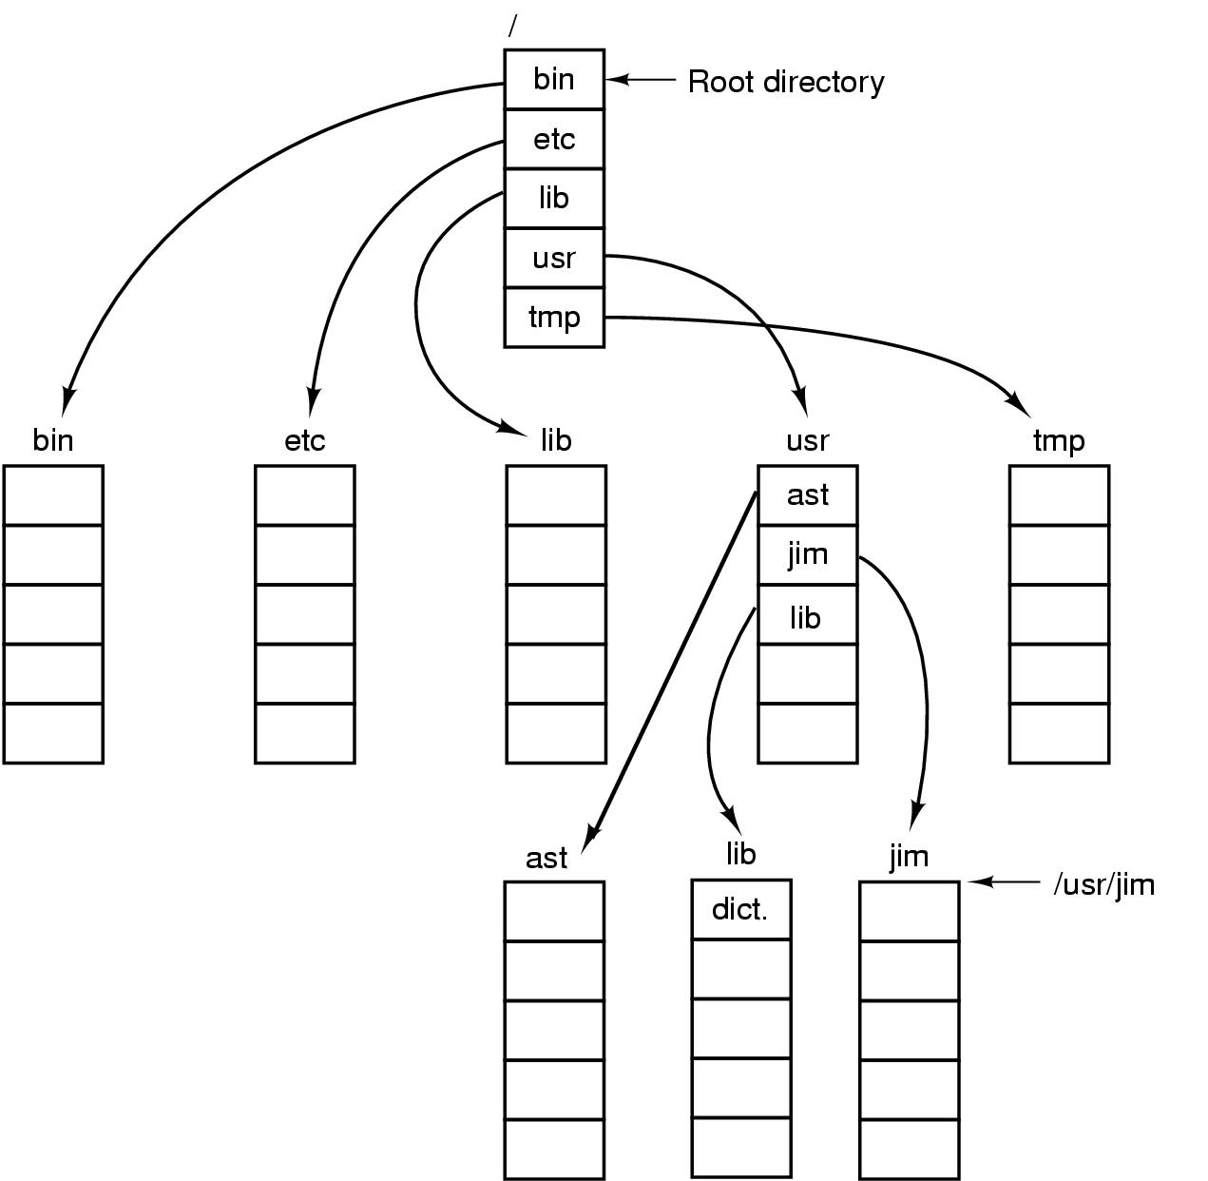
Directory Tree
A UNIX directory tree

Slide 33
Directory Operations
Create
Delete
Opendir
Closedir
Readdir
Rename
Link
Unlink
Linking is a technique that allows a file to appear in more than one directory.

Slide 34
File System Implementation

Slide 35
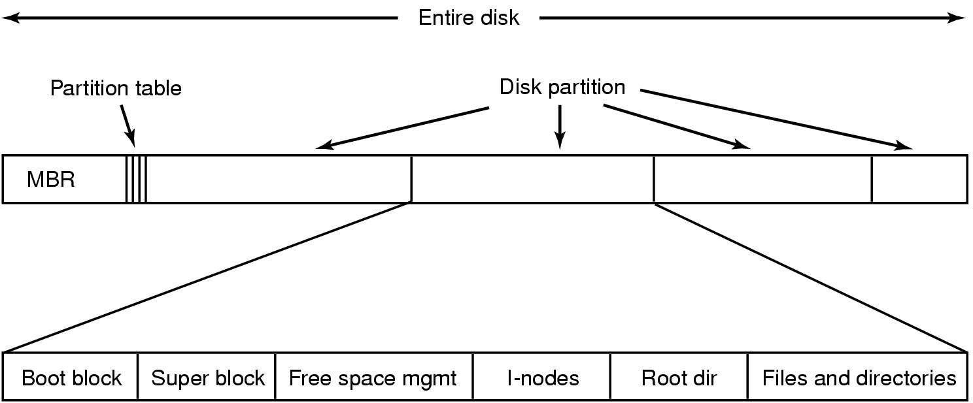
File System Layout
A possible file system layout

Slide 36
File System Layout (contd.)
Most disks can be divided up into one or more partitions, with independent file systems on each partition.
Sector 0 of the disk is called the MBR (Master Boot Record) and is used to boot the computer.
Partition table gives the starting and ending addresses of each partition.
  One of the partitions in the table is marked as active.

Slide 37
File System Layout (contd.)
When the computer is booted, the BIOS reads in and executes the MBR.
The first thing the MBR program does is locate the active partition, read in its first block (called the boot block) and execute it.
The program in the boot block loads the operating system contained in that partition.
For uniformity, every partition starts with a boot block, even if it does not contain a bootable operating system.

Slide 38
File System Layout (contd.)
Other than starting with a boot block, the layout of a disk partition varies a lot from file system to file system.
Superblock: contains all the key parameters about the file system and is read into memory when the computer is booted, or the file system is first touched.

Slide 39
Implementing Files
Probably the most important issue in implementing file storage is keeping track of which disk blocks go with which file.
Various methods such as
  Contiguous Allocation
  Linked-List Allocation
  Linked-List Allocation Using a Table in Memory
  i-nodes

Slide 40
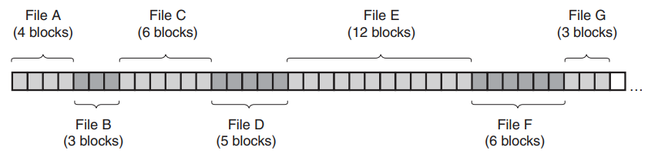
Contiguous Allocation
The simplest allocation scheme is to store each file as a contiguous run of disk blocks.
On a disk with 2-KB blocks, a 50-KB file would be allocated 25 consecutive blocks.
Each file begins at the start of a new block, so that if file A was really 3½ blocks, some space is wasted at the end of the last block.

Slide 41
Advantages of Contiguous Allocation
Contiguous disk-space allocation has two significant advantages.
First, it is simple to implement because keeping track of where a file’s blocks are is reduced to remembering two numbers:
  the disk address of the first block and
  the number of blocks in the file.
Second, the read performance is excellent because the entire file can be read from the disk in a single operation. Only one seek is needed (to the first block).

Slide 42

Disadvantage of Contiguous Allocation
(a) Contiguous allocation of disk space for 7 files
(b) State of the disk after files D and F have been removed
The disk ultimately consists of files and holes

Slide 43
Circumventing the Disadvantages
Compact the disk.
  Prohibitively expensive
Reuse the free space in the holes.
  Reusing the space requires maintaining a list of holes, which is doable.
  However, when a new file is to be created, it is necessary to know its final size in order to choose a hole of the correct size to place it in.

Slide 44
Usage of Contiguous Allocation
In CD-ROMs, all the file sizes are known in advance and will never change during subsequent use of the CD-ROM file system.
DVD movies are generally stored as three or four 1-GB files, each of which is contiguous.
  These physical pieces of the single logical file (the movie) are called extents.
Other examples: Blu-rays and other write-once optical media

Slide 45

Linked-List Allocation
Keep each file as a linked list of disk blocks.
The first word of each block is used as a pointer to the next one.
The rest of the block is for data.

Slide 46
Advantages of Linked-List Allocation
Unlike contiguous allocation, every disk block can be used in this method. No space is lost to disk fragmentation (except for internal fragmentation in the last block).
It is sufficient for the directory entry to merely store the disk address of the first block. The rest can be found starting there.

Slide 47
Disadvantages of Linked-List Allocation
Although reading a file sequentially is straightforward, random access is extremely slow.
  To get to block n, the operating system has to start at the beginning and read the n − 1 blocks prior to it, one at a time.
The amount of data storage in a block is no longer a power of two because the pointer takes up a few bytes.
  While not fatal, having a peculiar size is less efficient because many programs read and write in blocks whose size is a power of two.

Slide 48
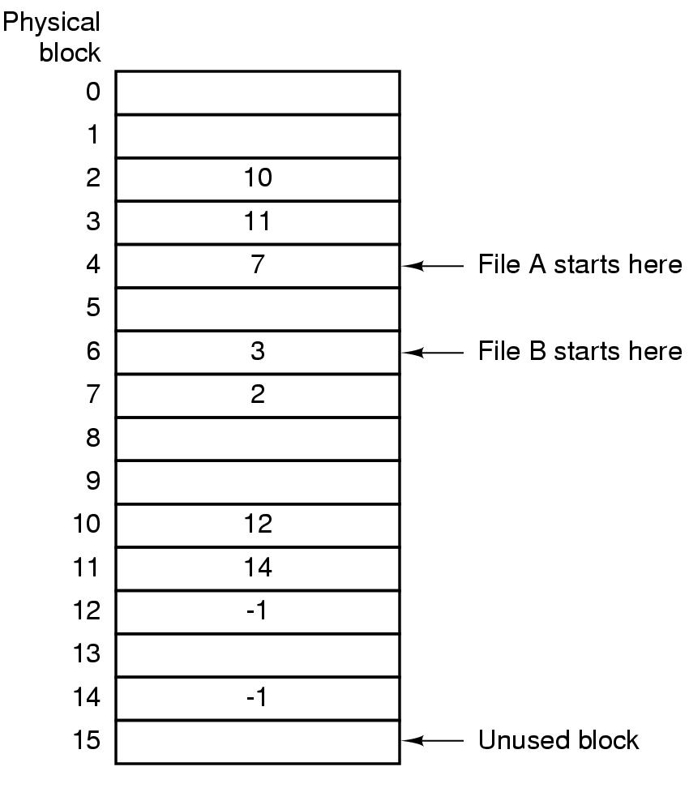
Linked-List Allocation Using a Table in Memory
Both disadvantages of the linked-list allocation can be eliminated by taking the pointer word from each disk block and putting it in a table in memory.
Such a table in main memory is called a FAT (File Allocation Table).

Slide 49
Advantages of Linked-List Allocation Using a Table in Memory
Random access is much easier. Although the chain must still be followed to find a given offset within the file, the chain is entirely in memory, so it can be followed without making any disk references.
It is sufficient for the directory entry to keep a single integer (the starting block number) and still be able to locate all the blocks, no matter how large the file is.

Slide 50
Disadvantage of Linked-List Allocation Using a Table in Memory
The entire table must be in memory all the time to make it work.
With a 1-TB disk and a 1-KB block size, the table needs 1 billion entries, one for each of the 1 billion disk blocks.
Each entry has to be a minimum of 3 bytes. For speed in lookup, they should be 4 bytes. Thus the table will take up 3-4 GB of main memory all the time. => does not scale well to large disks.
It was the original MS-DOS file system and is still fully supported by all versions of Windows though.

Slide 51
FAT-16 and FAT-32
FAT-16 indicates that the size of each entry in the file allocation table of a disk is 16 bits (2 bytes).
  For FAT-32, each entry is 32 bits (4 bytes).

Slide 52
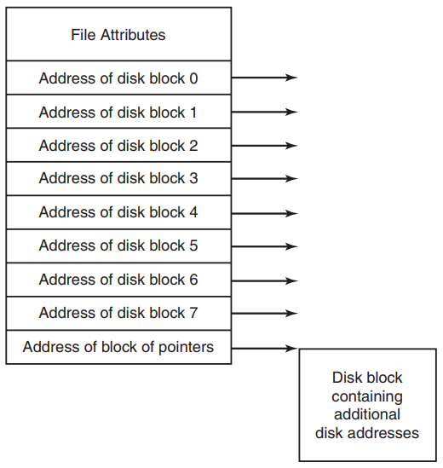
i-nodes
Associate with each file a data structure called an i-node (index-node), which lists the attributes and disk addresses of the file’s blocks (popularized by UNIX)
An example i-node (with an indirect addressing)

Slide 53
i-nodes (contd.)
The i-node needs to be in memory only when the corresponding file is open.
If each i-node occupies n bytes and a maximum of k files may be open at once, the total memory occupied by the array holding the i-nodes for the open files is only kn bytes.

Slide 54
i-nodes (contd.)
If each one has room for a fixed number of disk addresses, what happens when a file grows beyond this limit?
One solution is to reserve the last disk address not for a data block, but instead for the address of a block containing more disk-block addresses.
Even more advanced would be two or more such blocks containing disk addresses or even disk blocks pointing to other disk blocks full of addresses.
Windows NTFS file system uses a similar idea.

Slide 55
Implementing Directories
Before a file can be read, it must be opened.
When a file is opened, the operating system uses the path name supplied by the user to locate the directory entry on the disk.
The directory entry provides the information needed to find the disk blocks.
The main function of the directory system is to map the ASCII name of the file onto the information needed to locate the data.

Slide 56
Where The File Attributes Should Be Stored
Every file system maintains various file attributes, such as each file’s owner and creation time.
One obvious possibility is to store them directly in the directory entry.
  A directory consists of a list of fixed-size entries, one per file, containing a (fixed-length) file name, a structure of the file attributes, and one or more disk addresses (up to some maximum) telling where the disk blocks are.

Slide 57
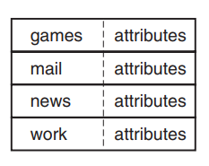
Storing File Attributes Directly in The Directory Entry
A simple directory containing fixed-size entries with the disk addresses and attributes in the directory entry

Slide 58
Storing File Attributes in the i-nodes
For systems that use i-nodes, another possibility for storing the attributes is in the i-nodes, rather than in the directory entries.
In that case, the directory entry can be shorter: just a file name and an i-node number.
This method has some advantages over putting them in the directory entry.

Slide 59
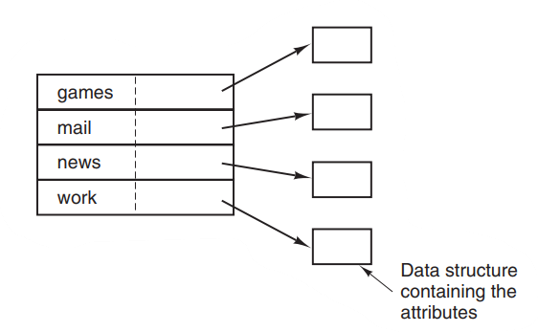
Storing File Attributes in the i-nodes (contd.)
A directory in which each entry just refers to an i-node

Slide 60
Handling Long File Names in Directory
Nearly all modern operating systems support long, variable-length file names.
The simplest approach is to set a limit on file-name length, typically 255 characters, and then keep 255 characters reserved for each file name.
This approach is simple, but wastes a great deal of directory space, since few files have such long names.
For efficiency reasons, a different structure is desirable.

Slide 61
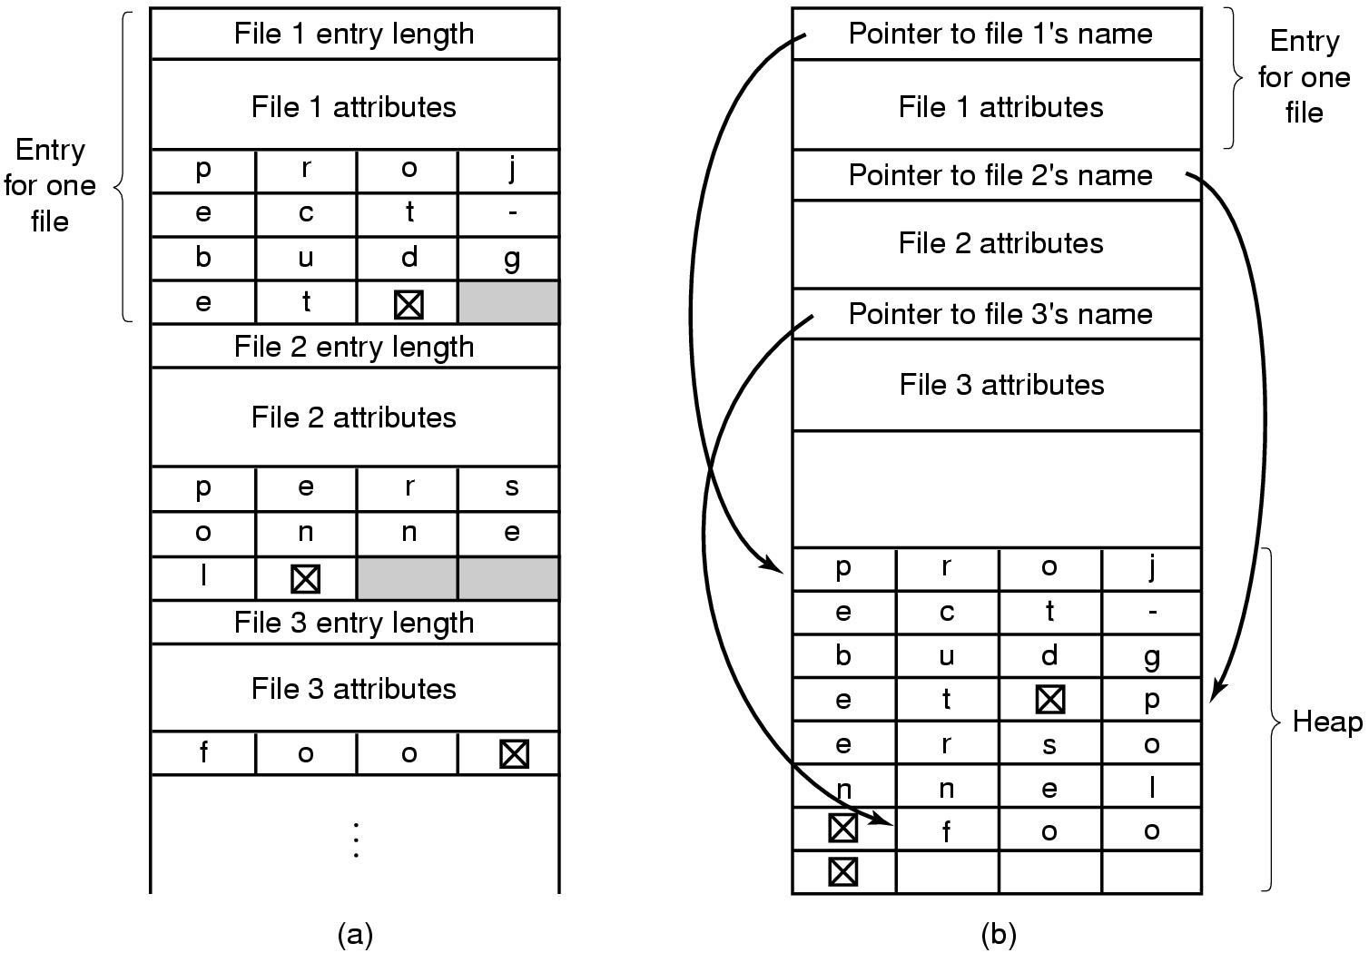
Handling Long File Names in Directory (contd.)
Two other ways of handling long variable-length file names in directory
  (a) In-line (b) In a heap

Slide 62
Searching Large Directories
In all of the designs so far, directories are searched linearly from beginning to end when a file name has to be looked up.
For extremely long directories, linear searching can be slow.
One way to speed up the search is to use a hash table (with chaining) in each directory.
Call the size of the table n. To enter a file name, the name is hashed onto a value between 0 and n − 1, for example, by dividing it by n and taking the remainder.

Slide 63
Searching Large Directories (contd.)
A different way to speed up searching large directories is to cache the results of searches.
Before starting a search, a check is first made to see if the file name is in the cache. If so, it can be located immediately.

Slide 64
Shared Files
It is often convenient for a shared file to appear simultaneously in different directories belonging to different users.

Slide 65
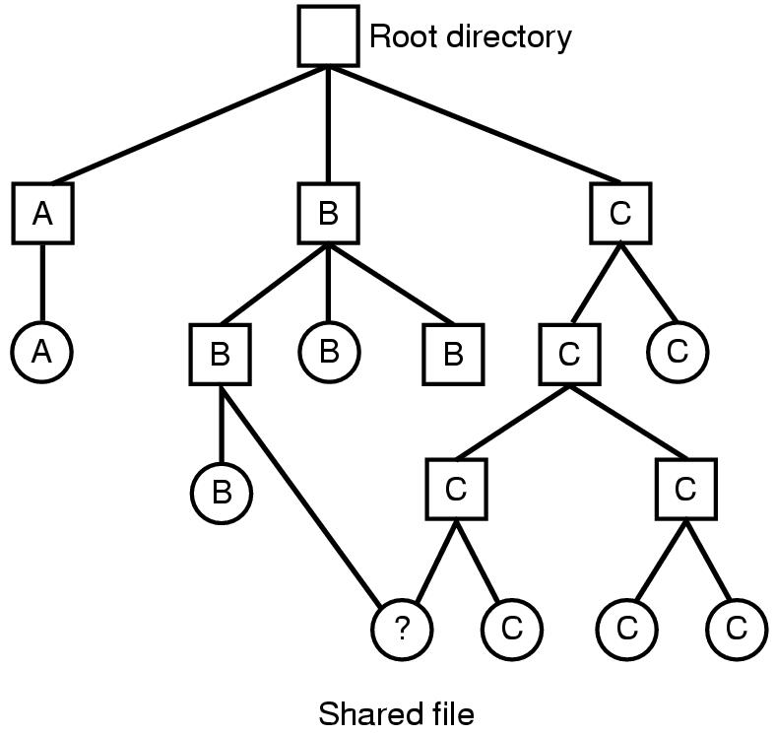
Shared Files (contd.)
The connection between B’s directory and the shared file is called a link.
The file system itself is now a Directed Acyclic Graph, or DAG, rather than a tree.
File system containing a shared file

Slide 66
Problems of Shared Files
If directories really do contain disk addresses, then a copy of the disk addresses will have to be made in B’s directory when the file is linked.
If either B or C subsequently appends to the file, the new blocks will be listed only in the directory of the user doing the append.
The changes will not be visible to the other user, thus defeating the purpose of sharing.

Slide 67
Solution 1
Disk blocks are not listed in directories, but in a little data structure associated with the file itself.
  i-node in UNIX
The directories would then point just to the little data structure. (hard linking)

Slide 68
Solution 2
B links to one of C’s files by having the system create a new file, of type LINK, and entering that file in B’s directory.
The new file contains just the path name of the file to which it is linked.
When B reads from the linked file, the operating system sees that the file being read from is of type LINK, looks up the name of the file, and reads that file.
This approach is called symbolic linking.

Slide 69
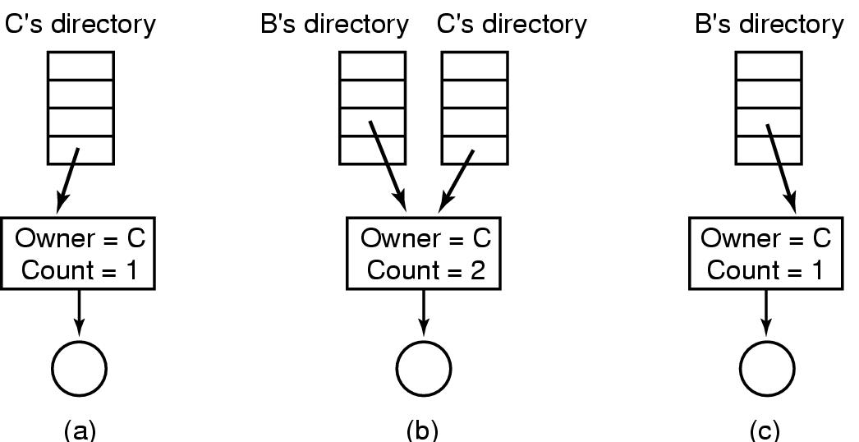
Hard Linking
(a) Situation prior to linking
(b) After the link is created
(c) After the original owner removes the file

Slide 70
Symbolic Linking
Only the true owner has a pointer to the i-node.
Users who have linked to the file just have path names, not i-node pointers.
When the owner removes the file, it is destroyed.
Subsequent attempts to use the file via a symbolic link will fail when the system is unable to locate the file.
Removing a symbolic link does not affect the file at all.

Slide 71
Advantage of Symbolic Linking
Symbolic links have the advantage that they can be used to link to files on machines anywhere in the world, by simply providing the network address of the machine where the file resides in addition to its path on that machine.

Slide 72
Disadvantage of Symbolic Linking
The problem with symbolic links is the extra overhead required.
The file containing the path must be read, then the path must be parsed and followed, component by component, until the i-node is reached.
All of this activity may require a considerable number of extra disk accesses.

Slide 73
Self-study (no question in exam)
Virtual File System
Disk Space Management
Keeping Track of Free Blocks

Slide 74
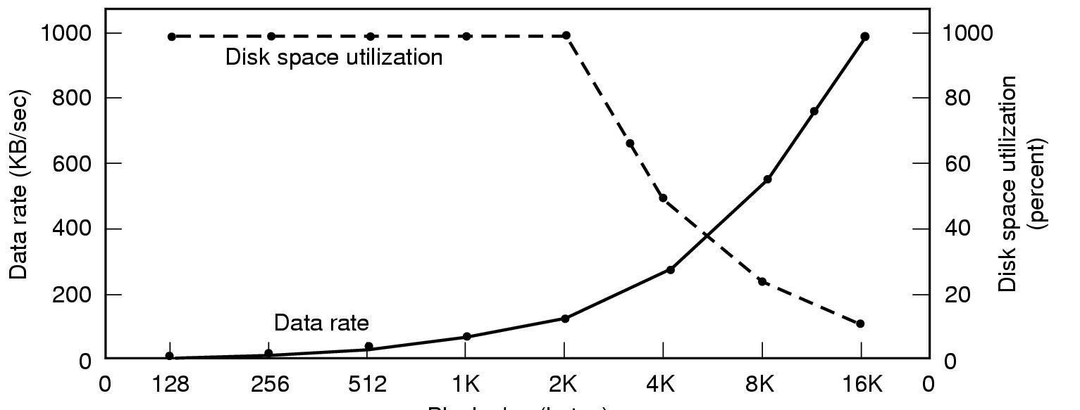
Disk Space Management (1)
Block size
Dark line (left hand scale) gives data rate of a disk
Dotted line (right hand scale) gives disk space efficiency
All files 2KB

Slide 75
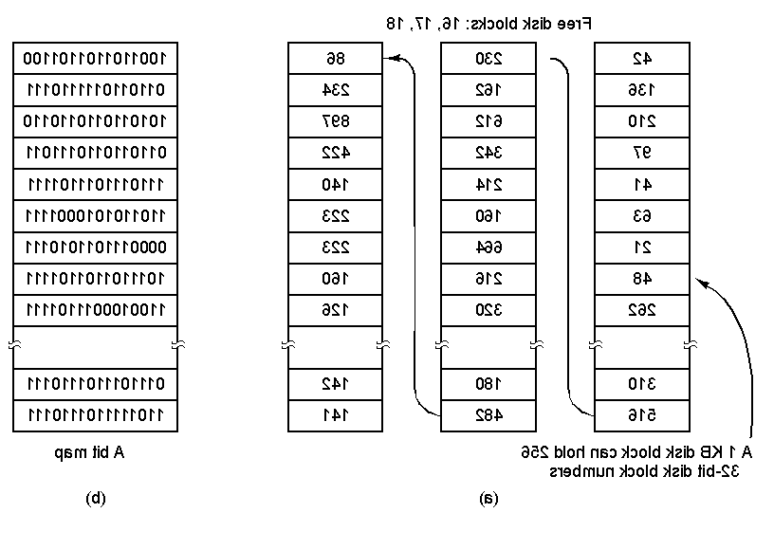
Disk Space Management (2)
(a) Storing the free list on a linked list
(b) A bit map

